Slide 1
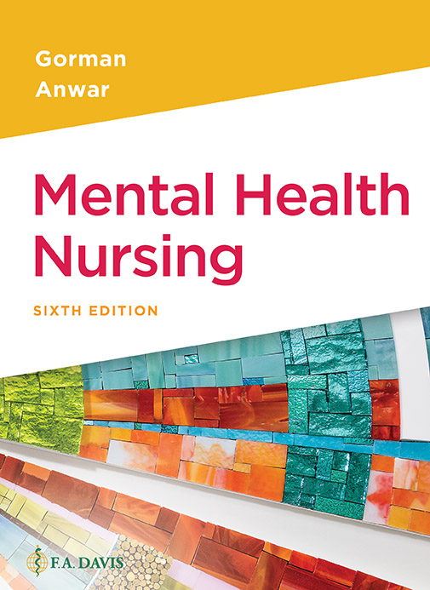

Book cover for Mental Health Nursing, Sixth Edition.
Chapter 5
Sociocultural Influences on Mental Health

Slide 2
Learning Outcomes
Define culture and cultural characteristics.
Identify factors to consider when assessing culture and ethnicity.
Differentiate between religion and spirituality.
Define ethnicity.
Identify three parenting styles.

Slide 3
Learning Outcomes (continued)
Define stereotype.
Define prejudice and bias.
Define homelessness.
Explain possible reasons for homelessness.
Identify nursing care for people who are homeless.

Slide 4
Culture
Social and cultural influences may have a great impact on the way people process life, as well as how they view illness, nursing care, and healing
Part of a nurse’s role is to learn about traits that are common among people as well as those that are different

Slide 5

Culture (continued_1)

Slide 6
Culture (continued_2)
Shared way of life
Combination of traditions/beliefs that make groups of people band together
Traditions that have been passed down over several generations (usually a minimum of three)
May or may not include a religion

Slide 7
Culture (continued_3)
CULTURE is not:
Based on color of skin
Based solely on country of origin

Slide 8
Clicker Question
Culture is based on skin color.
True
False
Notes:
Correct Answer: False
Rationale: Culture is a shared way of life, the combination of traditions and beliefs that make a group of people bond together (also see Chapter 3). It is not based on one’s color of skin or country of origin.

Slide 9
Clicker Question (continued_1)
All gestures are universal (for example, hand gestures).
True
False
Notes:
Correct Answer: False

Slide 10
Ethnicity
Ethnicity defines one’s personal traits
Skin color, country of origin, and language are part of one’s ethnicity
May be many ethnic groups within a culture

Slide 11
Ethnicity (continued)
ETHNOCENTRISM:
Believing ones ethnic group has rights or benefits over those of another group
Includes groups such as gangs, supremacist groups, and terrorist groups

Slide 12
Religion
Belief in a higher power (not the same for everyone)
Organized and structured
Deeply rooted and often stereotyped
A set of beliefs surrounding that higher power
Important to some patients and nonexistent to others

Slide 13
Religion (continued)
RELIGION may:
Influence the procedures a patient will allow
Determine who is allowed to care for that patient
Require services/ceremonies to be done at the bedside
Nurses need to be comfortable discussing patients’ needs pertaining to their religion or offer to get assistance from others who can help (chaplain, social worker, etc.)

Slide 14
Prejudice
Judging a person, group, or situation before knowing all the facts
Usually a negative connotation (although there are positive prejudices!)
Usually destructive
Usually hurtful
Restrictive to enrichment of society

Slide 15
Nontraditional Lifestyles
The definition of family has changed over the years to include biological parents, single parent, foster parents, blended families, and gay families

Slide 16
Nontraditional Lifestyles (continued)
July 2013 Supreme Court rulings gain victory on same-sex marriage
News about Same-Sex Marriage, Civil Unions, and Domestic Partnerships from The New York Times (2013, July 5). Retrieved July 5, 2013, from http://topics.nytimes.com/top/reference/timestopics/subjects/s/same_sex_marriage/index.html

Slide 17
Homelessness
Not a mental illness
Many homeless in the United States have a mental illness
Some homeless are “working poor” and either uninsured or underinsured
Deinstitutionalization in the 1950s may still be affecting the mentally ill homeless in this country

Slide 18
Economic Considerations
Eron and Peterson (1982)
Study found that the lower the socioeconomic status, the higher the incidence of abnormal behavior in U.S. society
It is important to know all the variables before applying this statement to your patient

Slide 19
Parenting
A learned behavior, culturally influenced
Diana Baumrind’s classification of parenting types
Authoritarian
Very strict rules
Child has little or no voice in family decisions
Authoritative
Firm, consistent rules and limits
Allows for discussion and flexibility
Notes:
Class Discussion
Authoritarian parent
Authoritative parent
Permissive parent

Slide 20
Parenting (continued)
Diana Baumrind’s classification of parenting types (continued)
Permissive
Little structure
Few guidelines
Child unsure of boundaries and has hard time learning self-control and situational appropriateness
Notes:
Class Discussion
Authoritarian parent
Authoritative parent
Permissive parent

Slide 21
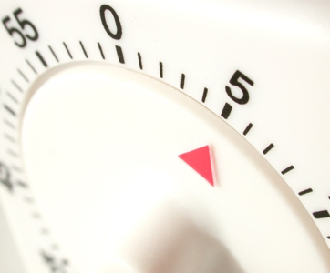
Clicker Question (continued_2)
According to Diane Baumrind, this style of parenting is known as:
Authoritarian parenting
Authoritative parenting
Permissive parenting
Practical parenting
Notes:
Correct Answer: B
Rationale: This style of parenting has firm, consistent rules and limits, while allowing for discussion and occasional flexibility of those rules, according to special circumstances.

Slide 22
Abuse
Misuse of a person, substance, or situation
Is growing in frequency in our society
A learned behavior in most cases (most abusers have at one time been abused)

Slide 23
Abuse (continued)
Abuse is abuse even when the abuser claims he/she is aware of his/her actions and feels confident in what is being done (example, excessive punishment of a child, withholding basic needs, excessive behaviors such as drinking that the person says he/she is “perfectly aware and in control of,” etc.)

